Slide 1
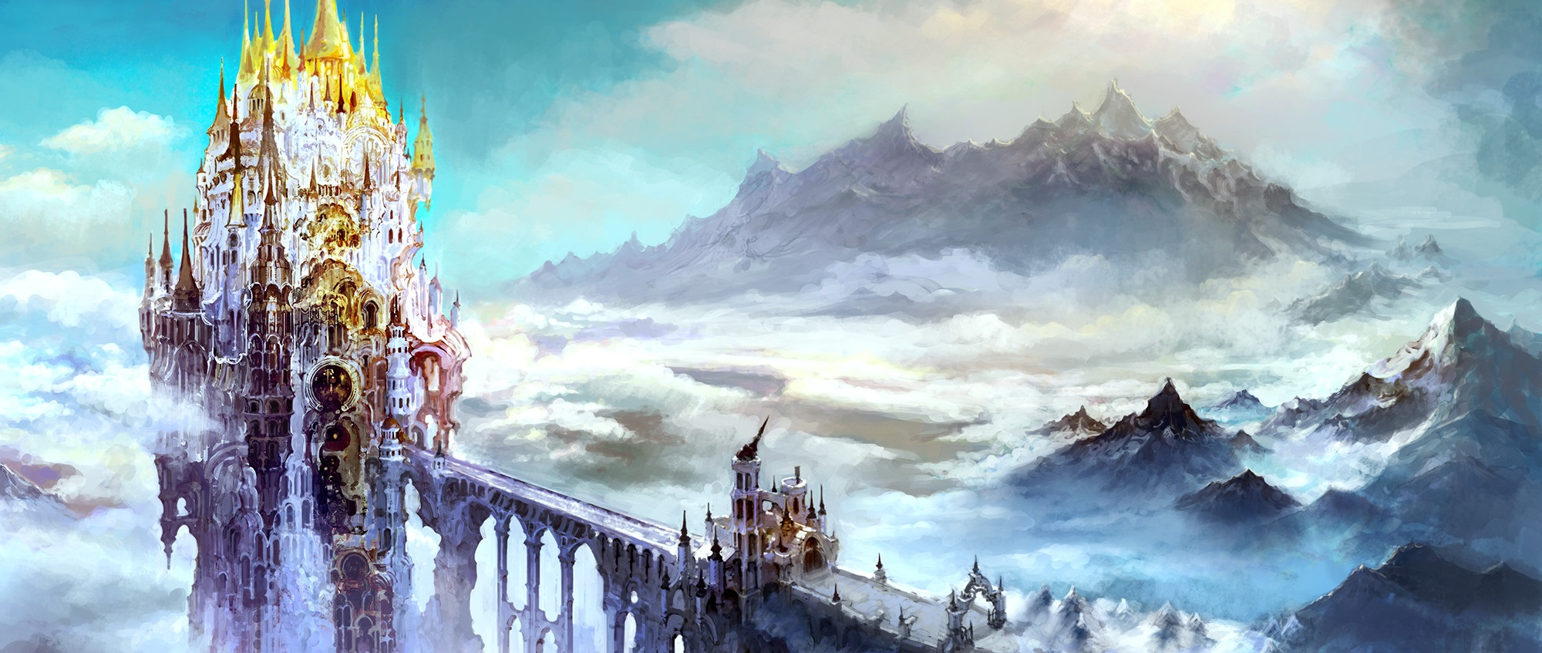
Spira Contact Manager

Slide 2
Group Members (Group #7)
Brian: Database, ER/Gantt/Use Case Diagrams, Powerpoint
Craig: Front End
Jordan: API
Andrew: Back End
Sami: Back end / Front end / Project Manager

Slide 3
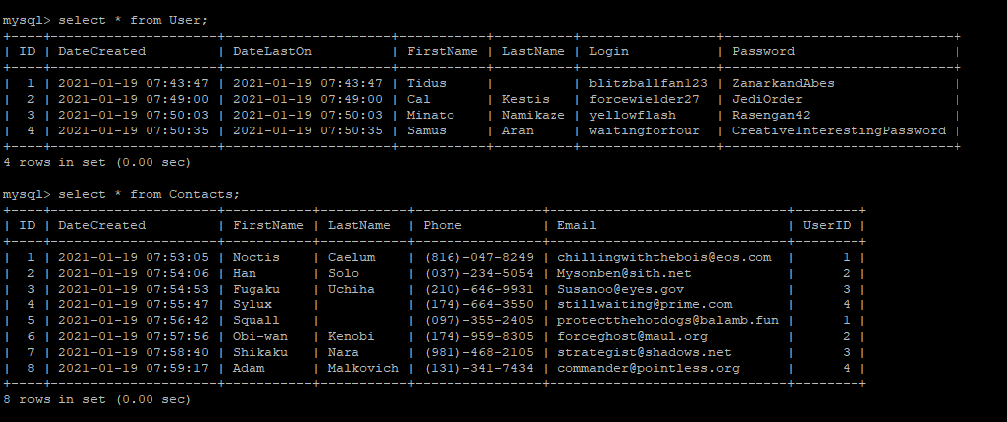
How It Was Developed
Developed using a LAMP stack through a DigitalOcean Server
MySQL (included in the server tools) was used to maintain a database
**Jordan please add some notes about API here, maybe swaggerhub?**

Slide 4

How It Was Developed (cont.)
Front End:
The font end of Spira was developed with a combination of javaScript, Css and Html. The Html is the layout of the website with the Css providing styling. The javaScript’s funtion is to manipulate how the html looks and provide funtions to buttons as well as communicating information to API endpoints in the backend via JSON objects.
Back End:
**Andrew and Sami add notes and a picture here please**

Slide 5
Important Things We Noticed
**not really sure what he wants with this slide, this one is prob where we earn his extra 10 discretionary points**

Slide 6
What Went Well
Group members communicated efficiently
Deadlines were met with plenty of time to spare
The LAMP stack and well documented notes from the professor, combined with the division of the work amongst the team, really allowed me to dedicate myself to and learn about one area
Individuals work meshed well without any conflicting errors

Slide 7
What Went Poorly
**complete closer to due date**

Slide 8
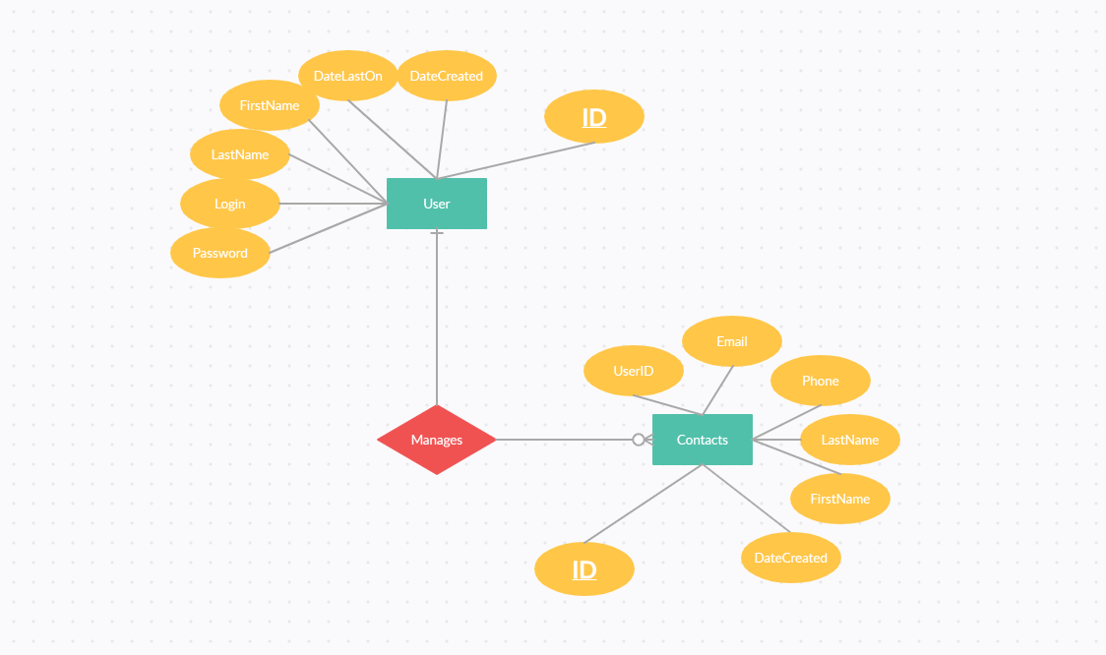
ERD(Entity Relationship Diagram)

Slide 9
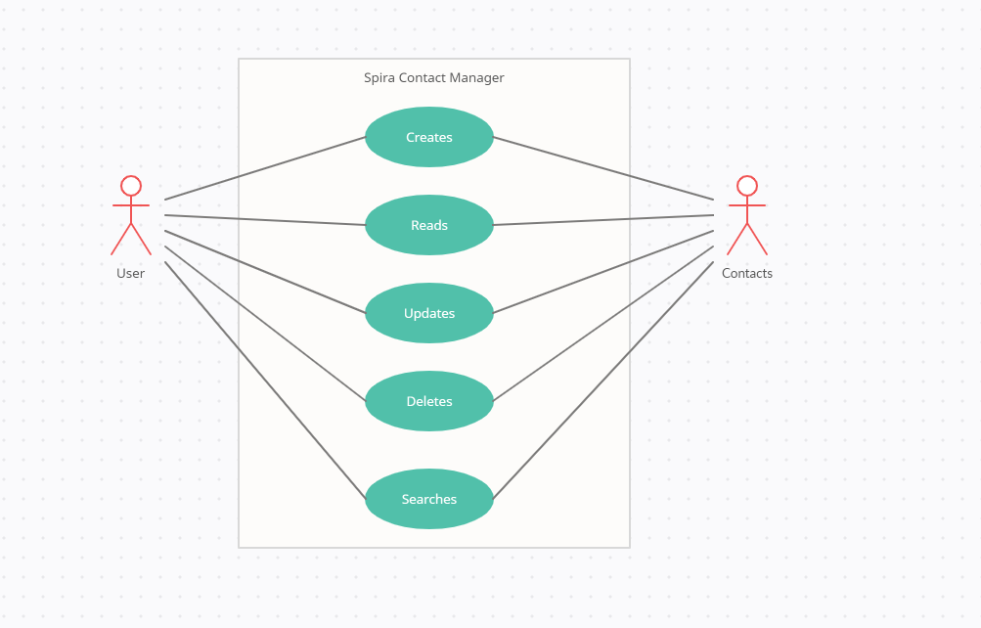
Use Case Diagram

Slide 10
Gantt Chart
**update this closer to due date**

Slide 11

Demo

Slide 12
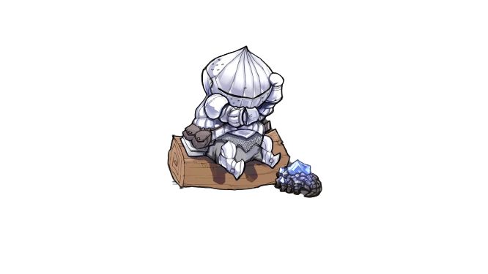
Questions?

Slide 13
Spira thanks you for your time

